Slide 1
openCV + Qt5 +Raspberry pi 광운대학교 허준호
simple form of image processing with Pi camera on Qt widget

Slide 2
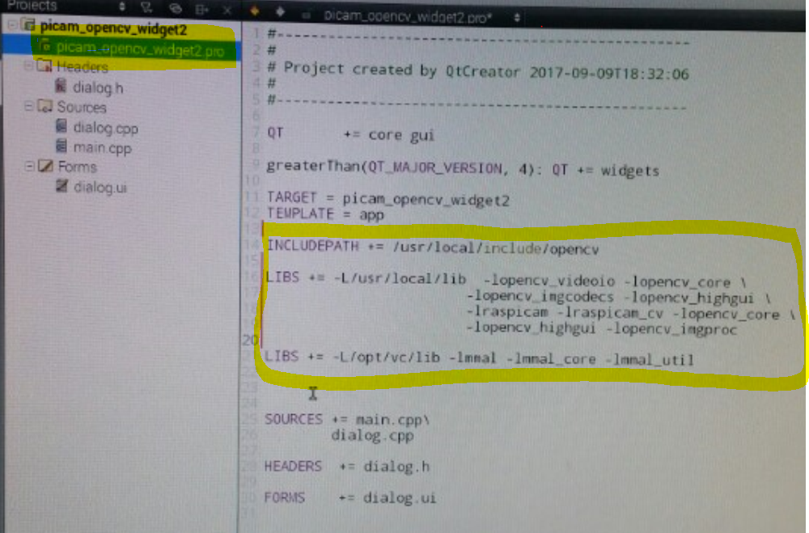
how to link openCV Libraries
.pro파일에 라이브러리 디렉토리와 항목들을 추가

Slide 3
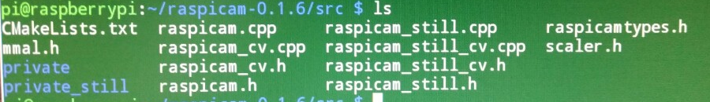
Raspicam with openCV
https://github.com/cedricve/raspicam
github 다운로드 후 빌드(~$ git clone http://....)
파이카메라에 openCV 함수들을 사용하기 위해 <raspicam_cv.h>가 필요

Slide 4
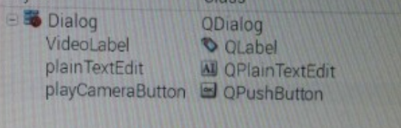
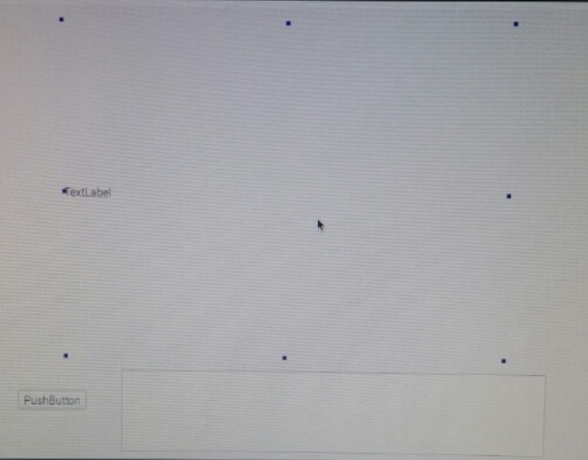
UI
<이름을 위와 같이 변경>
동영상 재생 - QLabel
정지/재생 버튼 – QPushButton
RGB값 출력 – QPlainTextEdit

Slide 5
dialog.h
#include <QDialog>
#include <iostream>
#include <raspicam/raspicam_cv.h>
#include <opencv2/opencv.hpp>
#include <opencv2/core/core.hpp>
#include <opencv2/highgui/highgui.hpp>
#include <opencv2/features2d/features2d.hpp>
#include <opencv2/shape.hpp>
#include <opencv2/imgproc/imgproc.hpp>
#include <opencv2/imgproc.hpp>
namespace Ui {class Dialog;}
class Dialog : public QDialog {
Q_OBJECT
public:
explicit Dialog(QWidget *parent = 0);
~Dialog();
public slots:
void processFrameAndUpdateGUI();
private slots:
void on_playCameraButton_clicked();
private:
Ui::Dialog *ui;
raspicam::RaspiCam_Cv Camera;
cv::Mat image;
QImage qimgOrinigal;
QTimer* tmrTimer;
};

Slide 6
dialog.cpp
#include "dialog.h"
#include "ui_dialog.h"
#include <QtCore>
#define ROI_LEN 10
#define ROI_START_X 300
#define ROI_START_Y 200
Dialog::Dialog(QWidget *parent) :
QDialog(parent),
ui(new Ui::Dialog)
{
ui->setupUi(this);
Camera.set(CV_CAP_PROP_FORMAT, CV_8UC3);
Camera.set(CV_CAP_PROP_FRAME_WIDTH, 640);
Camera.set(CV_CAP_PROP_FRAME_HEIGHT, 480);
//int delay = (int)(1000/Camera.get(CV_CAP_PROP_FPS));
if(!Camera.open())
{
ui->plainTextEdit->appendPlainText("error : Picam not accessed successfully");
return;
}
tmrTimer = new QTimer(this);
connect(tmrTimer, SIGNAL(timeout()), this, SLOT(processFrameAndUpdateGUI()));
tmrTimer->start(20);
}
Dialog::~Dialog()
{
delete ui;
}

Slide 7
dialog.cpp
void Dialog::on_playCameraButton_clicked()
{
if(tmrTimer->isActive()==true)
{
tmrTimer->stop();
ui->playCameraButton->setText("resume");
}
else
{
tmrTimer->start(20);
ui->playCameraButton->setText("pause");
}
}
void Dialog::processFrameAndUpdateGUI()
{
Camera.grab();
Camera.retrieve(image);
if(image.empty() == true)
return;
cv::Vec3b rgb;
int blueSum=0;
int redSum=0;
int greenSum=0;
int blueAv, redAv, greenAv;
cv::Rect roi(315, 235, 10, 10);
cv::Scalar color(0, 255, 255);
cv::rectangle(image, roi, color, 2);
cv::Point roi_point;
roi_point.x = 320;
roi_point.y = 240;
rgb = image.at<cv::Vec3b>(roi_point);
int r = rgb.val[2];
int g = rgb.val[1];
int b = rgb.val[0];
ui->plainTextEdit->appendPlainText(QString("Red average : ")+QString::number(r).rightJustified(4, ' ')
+QString("Green average : ")+QString::number(g).rightJustified(4, ' ')
+QString("Blue average : ")+QString::number(b).rightJustified(4, ' '));
cv::cvtColor(image, image, CV_BGR2RGB);
QImage qimgOriginal((uchar*)image.data, image.cols, image.rows, image.step, QImage::Format_RGB888);
ui->VideoLabel->setPixmap(QPixmap::fromImage(qimgOriginal));
}

Slide 8
main.cpp
#include "dialog.h"
#include <QApplication>
int main(int argc, char *argv[])
{
QApplication a(argc, argv);
Dialog w;
w.show();
return a.exec();
}

Slide 9
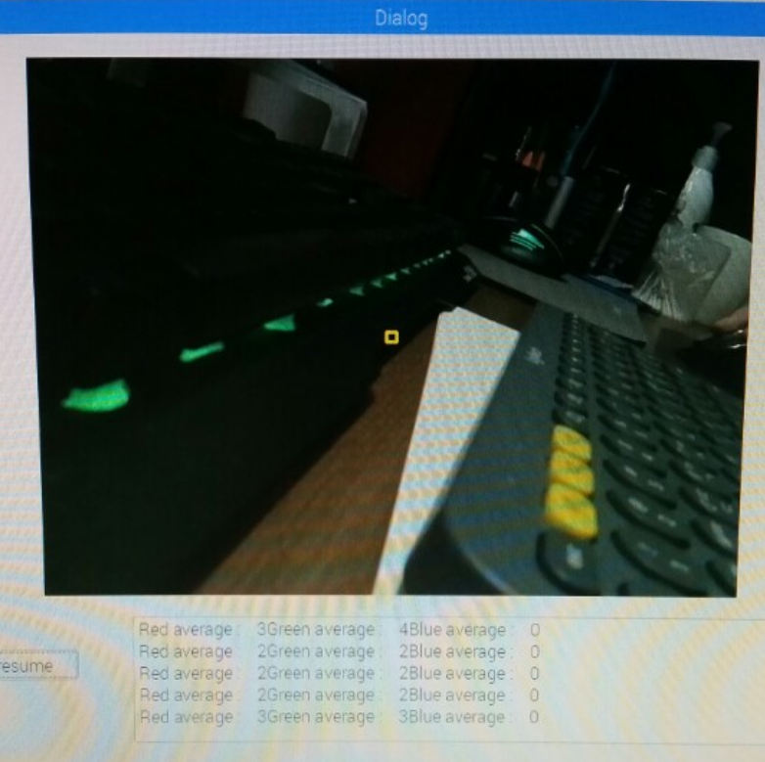
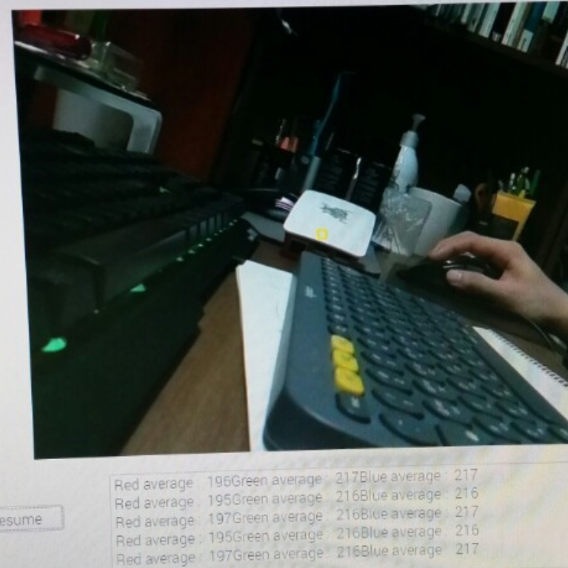
Result

Slide 10
References
https://github.com/cedricve/raspicam
- 라이브러리 소스
https://www.youtube.com/watch?v=0ONxIy8itRA
- 위젯 형식 참조

